Slide 1
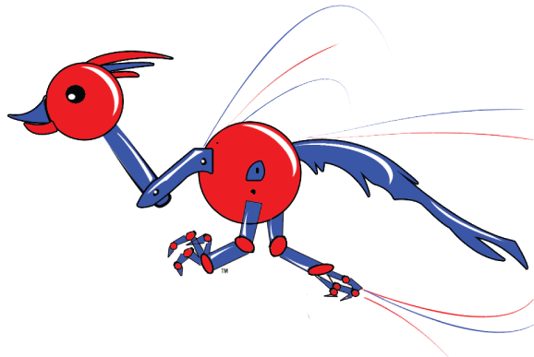
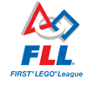
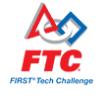
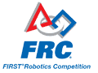
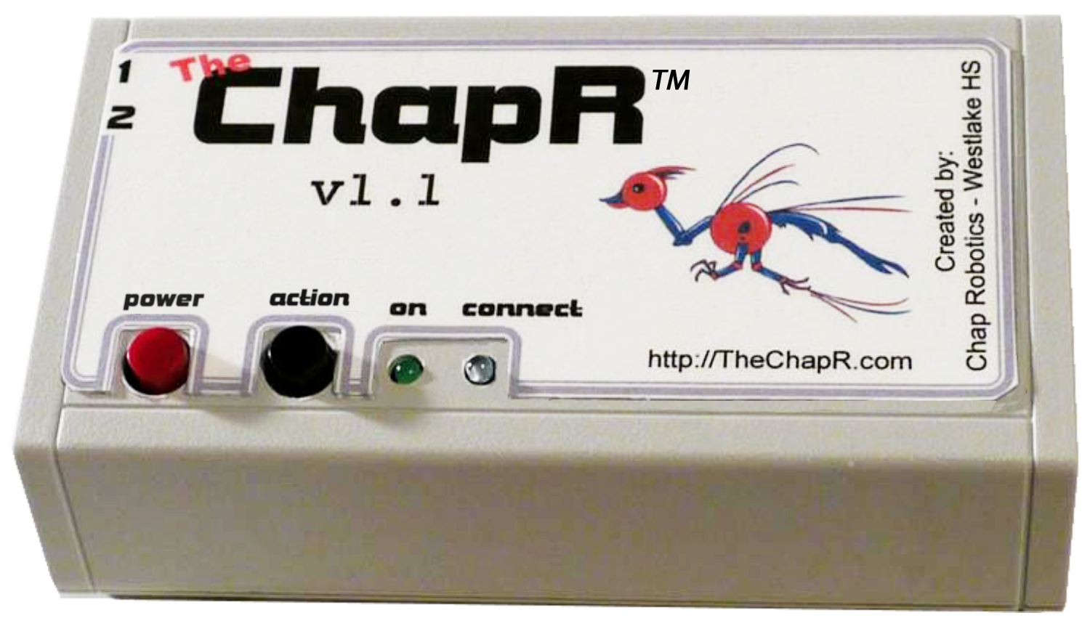
Chap Robotics
FTC 3781
FRC 2468
Creator of
Drive any NXT robot
FTC drive practice without a PC
FRC compatible
Quick connection
Patent pending
ChapR
The

Slide 2
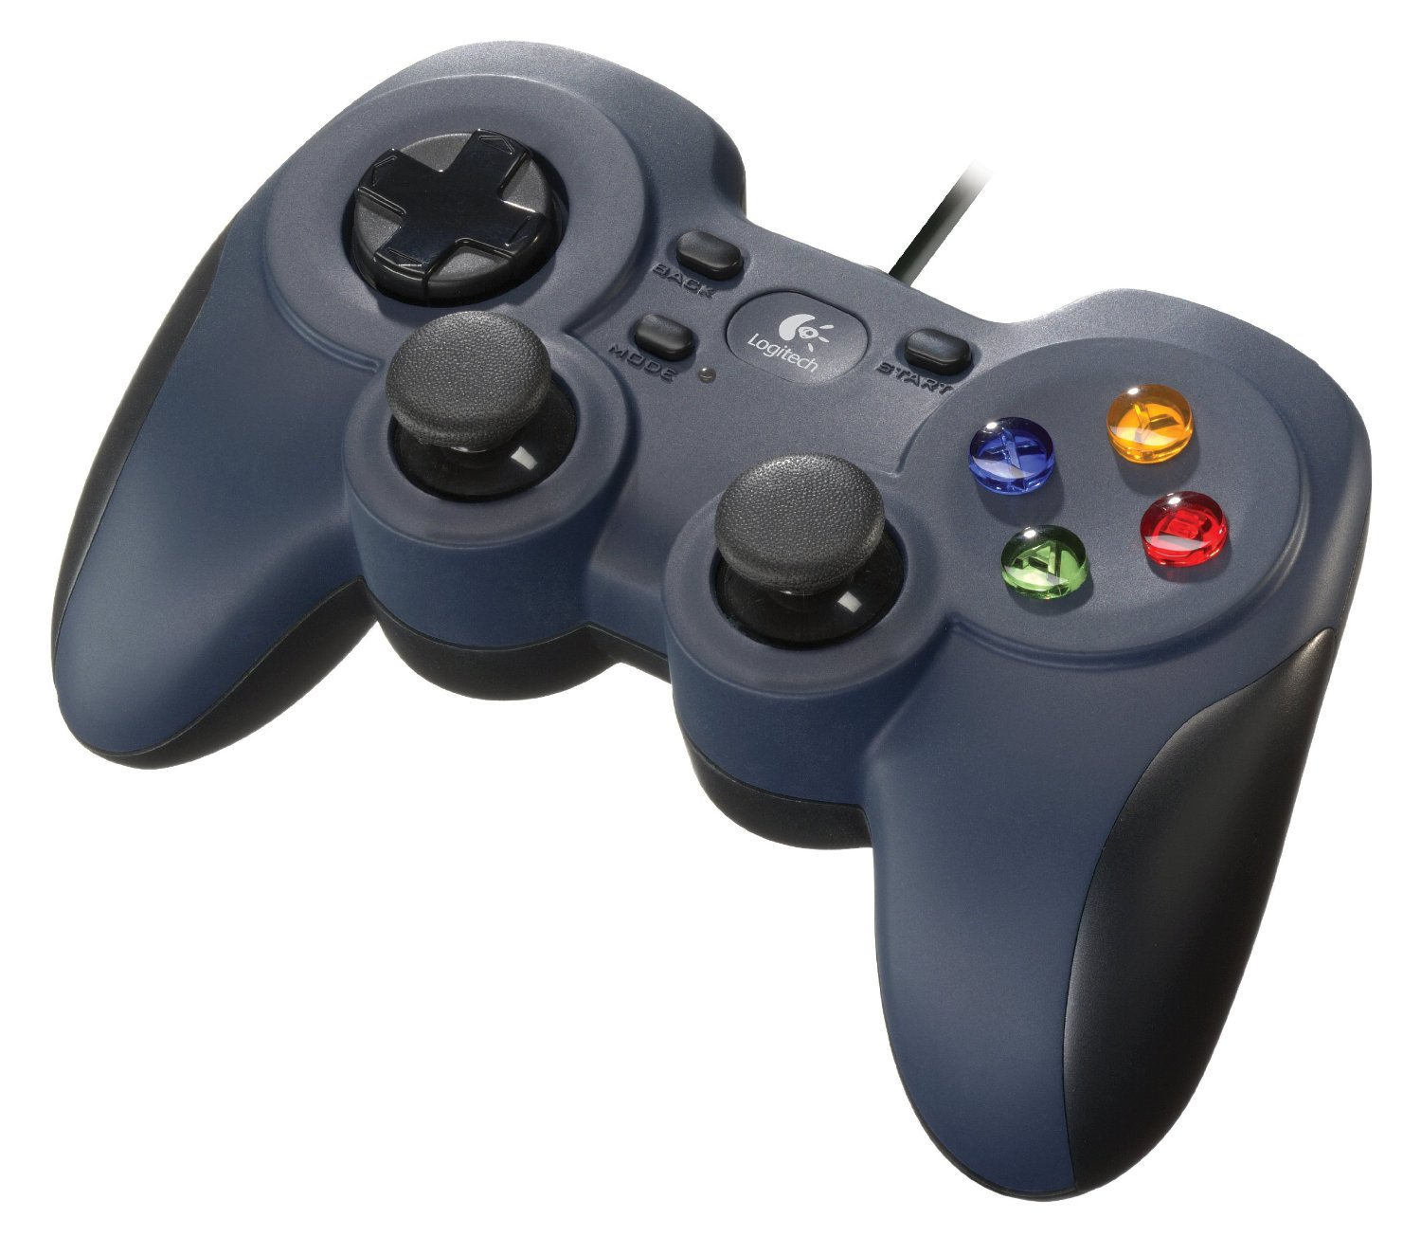
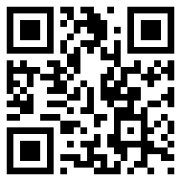
Chap Robotics
FTC 3781
FRC 2468
Creator of
Drive any NXT robot
FTC drive practice without a PC
FRC compatible
Quick connection
Patent pending
Bluetooth remote control!
Patent pending!
Compatible with FLL, FTC and FRC!
Used for testing, practice, demos, education and more!

Slide 3

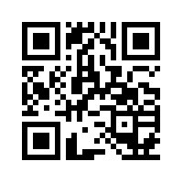
FRC 2468
Chap Robotics
FTC 3781
Creator of
Patent Pending
*
Not actual size. The real ChapR is much smaller!
 FTC Drive Practice Without a PC!
 FRC Demo Driving!
 FLL Robot Add-on Remote!
The ChapR is a 2-controller USB/Bluetooth remote control compatible with FTC, FRC, and FLL robots. It can be used for testing, practice, demos, education, and more! The ChapR is battery powered and connects to your robot extremely quickly for non-stop driving.
Chap Robotics
Westlake High School
Austin, TX
www.TheChapR.com

Slide 4
